Slide 1
Agile Methodology
Chapter 2-Second part

Slide 2
Agile SDLC
Combination of iterative and incremental process models.
Focus on process adaptability and customer satisfaction
Agile Methods break the product into small incremental builds.
These builds are provided in iterations.
Each iteration typically lasts from about one to three weeks..

Slide 3
What is Agile?
Agile model believes that every project needs to be handled differently and the existing methods need to be tailored to best suit the project requirements.
Tasks are divided to time boxes (small time frames) to deliver specific features for a release.
Iterative approach is taken and working software build is delivered after each iteration.
Each build is incremental in terms of features, the final build holds all the features required by the customer

Slide 4
Agile SDLC
Every iteration involves cross functional teams working simultaneously on various areas like −
Planning
Requirements Analysis
Design
Coding
Unit Testing and
Acceptance Testing.
At the end of the iteration, a working product is displayed to the customer and important stakeholders

Slide 5
Agile Principle
Customer Involvement
Incremental delivery
People not Process
Embrace change
Maintain Simplicity

Slide 6
Agile Vs Traditional SDLC Model
Agile is based on the adaptive software development methods, whereas the traditional SDLC models like the waterfall model is based on a predictive approach
Customer Interaction is the backbone of this Agile methodology,
Open communication with minimum documentation are the typical features of Agile development environment

Slide 7
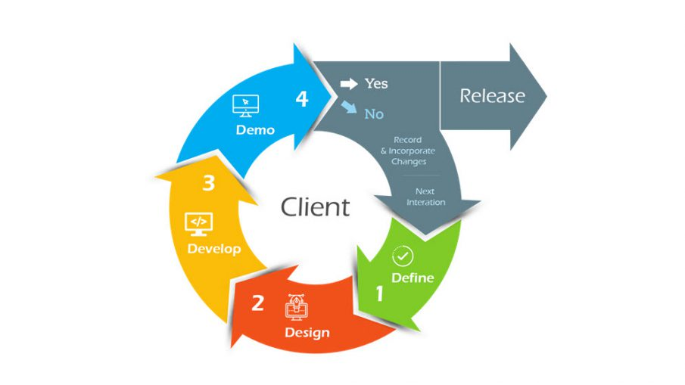
Agile SDLC

Slide 8
Advantages
Realistic approach to software development.
Promotes teamwork and cross training.
Resource requirements are minimum.
Suitable for fixed or changing requirements
Good model for environments that change steadily.
Minimal rules, documentation easily employed.
Little or no planning required.

Slide 9
Disadvantages
More risk of sustainability, maintainability and extensibility.
An overall plan, an agile leader and agile PM practice is a must without which it will not work.
Depends heavily on customer interaction, so if customer is not clear, team can be driven in the wrong direction.
There is a very high individual dependency, since there is minimum documentation generated.
Transfer of technology to new team members may be quite challenging due to lack of documentation.

Slide 10
When to use the Agile Methodology?
Unclear or Changing Requirements: Agile is great for projects with requirements that aren’t well-defined or might change.
Complex Projects: It’s good for big, complex projects by breaking them into smaller pieces.
Customer Focus: Use Agile when making customers happy is a priority and you want to involve them throughout.
Quick Time-to-Market: If you need to get your product out fast, Agile can help.
Small to Medium Teams: Agile works well for teams of a few to a few dozen people.

Slide 11
When to use the Agile Methodology?
Team Skills: It’s best when you have a mix of skills in your team, like development, testing, design, and more.
Collaboration: Agile promotes working together and open communication.
Regular Updates: If you want to check progress often and make changes as needed.
Transparency: Agile emphasizes being open and clear with everyone involved in the project.
Risk Control: It helps manage risks by tackling issues as they come up.
Innovation: If you encourage trying new things and learning from experience, Agile supports that.
Continuous Improvement: Agile fosters a culture of always getting better over time.

Slide 12
Agile Project Management
Agile project management is an interactive approach to manage software development.
Agile project management focuses on continuous releases and covers customer feedback every iteration.
Traditionally the agile project management is classified into two frameworks: scrum and kanban.
The scrum framework focused on fixed-length project iterations, whereas the kanban framework focused on continuous releases.
After the competition of the project’s first iteration (or steps) project management activity immediately moves on to the next.

Slide 13
Scrum
Scrum is a popular framework within Agile project management.
It is designed to help teams work together to deliver complex products incrementally.
Scrum is particularly suited for projects with rapidly changing or unclear requirements.
Key Components of Scrum are:-
Roles
Product Backlog
Sprint
Scrum Process

Slide 14
1. Roles
Product Owner: Represents the customer or stakeholders and is responsible for defining the product backlog, prioritizing items, and ensuring the team delivers value.
Scrum Master: Facilitates the Scrum process, helps the team follow Scrum practices, and removes any obstacles to progress.
Development Team: A cross-functional group responsible for delivering potentially shippable increments of the product at the end of each sprint.

Slide 15
2. Artifacts:Product Backlog:
A prioritized list of features, enhancements, and fixes that make up the project, Managed by the Product Owner.
Sprint Backlog: A subset of items from the product backlog selected for completion during the current sprint.Owned by the development team.
Increment: The sum of all completed backlog items during a sprint. It should be in a releasable state, even if the Product Owner chooses not to release it.

Slide 16
3. Events:Sprint:
A time-boxed iteration, typically 1-4 weeks long, during which the team works on a set of backlog items to create a product increment.
Sprint Planning: A meeting where the team decides what backlog items will be worked on during the sprint.
Daily Scrum (Standup): A short daily meeting where the team discusses progress, what they plan to do, and any impediments.
Sprint Review: Held at the end of the sprint to showcase the completed work and get feedback from stakeholders.Sprint
Retrospective: A meeting to reflect on the sprint, discussing what went well, what could be improved, and how to make adjustments.

Slide 17
4. Scrum Process:
Scrum operates in cycles (sprints), where the team commits to completing specific items from the backlog.
After each sprint, the team reviews progress, gathers feedback, and refines their processes.

Slide 18
Plan Driven and Agile Development
A plan-driven development is a process where all the activities are planned in advance, and we measure the progress in advance against that plan.
While in agile development, planning is always incremental, where you can change the plan according to your customer requirements.
So, as the term ‘agile development’ suggests, it is the process-based method where one can alter the way things and planning and replace them with the more suitable ones.

